Slide 1

NOIDA INSTITUTE OF ENGINEERING & TECHNOLOGY GREATER NOIDA
MBA Project Management and AMBA0401
Lecture – 1 Topic: Budgeting the project
By
Tarun Maheshwari
Assistant Professor
MBA
NIET, GREATER NOIDA

Slide 2
Index
S No | Content
1 | Name of Subject with code, Course and Subject Teacher
2 | Brief Introduction of Faculty member with Photograph
3 | Evaluation Scheme
4 | Syllabus
5 | Branch wise Application
6 | Course Objective(s)
7 | Course Outcome(s)
8 | Program Outcomes (POs)
9 | COs and POs Mapping
10 | Program Educational Objectives (PEOs)
11 | Result Analysis
12 | End Semester Question paper Templates
13 | Prequisite/Recap

Slide 3
Index
S No | Content
14 | Brief Indtroduction about the Subject with Videos
15 | Unit Content
16 | Unit Objectives
17 | Topic Objectives & Topic Outcome
18 | Lecture related to topic
19 | Daily Quiz
20 | Weekly Assignment
21 | Topic Links
22 | MCQs
23 | Glossary Questions
24 | Old question papers
25 | Expected Questions
26 | Recap of unit

Slide 4
Brief Introduction of the Faculty Member
Faculty Name: Tarun Maheshwari
Designation: ASSISTANT PROFESSOR
Department: PGDM
Email ID: tarun.maheshwari@niet.co.in
Qualification: MBA PG Diploma in Training & Development
Specialization: Finance & Human Resource Management
Teaching Area: Management (Finance & Core subjects)
Total Experience: 11 years

Slide 5
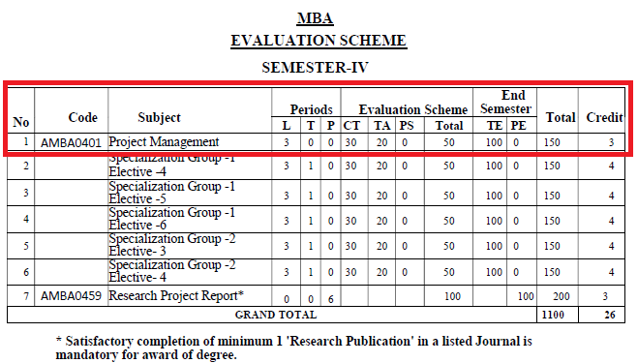
Evaluation Scheme

Slide 6
Syllabus
Course Contents / Syllabus
UNIT-I | Introduction of Project | 06 Hours
Projects – Definition and Objectives – Project Management Vs General Management – Roles and Responsibilities of Project Manager – Selection of Project Manager – Selection of Projects – Understanding Project Life Cycle. Project Team and Scope of Project Management: Characteristics of a Project Team & Project Leader, Project Organization, and Importance of Project Management. Case Studies
UNIT-II | Project Identification & Selection | 08 Hours
Project Identification & Selection: Identification, Generation of ideas, Approaches to Project Screening and Selection, Project Rating Index. Market & Demand Analysis Techniques: Survey & Trend Projection Methods. Project Risk Management: Concepts and Types of Project Risks, Risk Identification, Risks Analysis, Risks Mitigation Strategies. Case Studies
UNIT-III | Budgeting the Project | 08 Hours
Fundamental components of Project Cost, Types of Costs: Direct, Indirect, Recurring, Non-Recurring, Fixed, Variable, Normal, Expedite costs Methods of budgeting – Project cost estimation – Improving cost estimates – Budget uncertainty and risk management – Scheduling the project – Gantt chart – Resource allocation and loading – Social Cost Benefit Analysis (SCBA) of Project: Concept & significance of SCBA, Approaches to SCBA. Case Studies

Slide 7
Syllabus
UNIT-IV | Project Scheduling and Network Analysis | 08 Hours
Steps in Project Scheduling and Network design, Gantt Chart, Work Breakdown Structure (WBS) & Responsibility Assignment Matrix. Project Network Design: Identifying the Nodes and Activities, Activity on Arrow (AoA) and Activities on Node (AoN) methods, Introduction to PERT and CPM, Crashing in Projects. Case Studies
UNIT-V | Monitoring and controlling the project | 6 Hours
Monitoring the project – Control cycle – Project control – Designing the control system – Evaluation of project: Milestone Analysis and Tracking Gantt chart. Earned Value Analysis (EVA): Planned Value (PV), Earned Value (EV), Cost Variance (CV), Schedule Variance (SV), Cost performance Index (CPI), Schedule performance Index (SPI) – Project auditing – Project termination: Types of Terminations, Project Termination Process. Case Studies

Slide 8
Branch Wise Application
Handling projects.
Evaluating & Monitoring Project Process
Taking necessary and corrective action.

Slide 9
Course objective(s)
To empower the students to get insights of basic concepts on project management.
To create awareness on the roles and responsibilities of project manager.
To build the confident among the students to take up any kind of projects.
To sharpen the planning, scheduling and controlling skills of the students with respect to individual projects.
To understand the perspectives in which optimum decisions are to be taken in case of risks with planned activities in project.

Slide 10
Course outcome(s)
CO 1 | Understand the basic concepts and characteristics of Project and Project manager, management | Understanding (K2)
CO 2 | Understand the roles and responsibilities along with tools & techniques used in Project Management | Evaluating (K5)
CO 3 | Develop confident to take up any kind of projects | Evaluating (K5)
CO 4 | Students will understand the scheduling and monitoring process in Project. They will be able to apply PERT and CPM method for project scheduling | Applying (K3)
CO 5 | Students will understand the perspectives in which optimum decisions are to be taken in case of risks with planned activities in project | Creating (K6)

Slide 11
Program outcome (POs)
PO1. Apply knowledge of management theories and practices to solve business problems.
PO2. Foster analytical and critical thinking abilities for data-based decision-making.
PO3. Ability to develop value-based leadership ability.
PO4. Ability to understand, analyze, and communicate global, economic, legal, and ethical aspects of business.
PO5. Ability to lead themselves and others in the achievement of organizational goals, contributing effectively to a team environment.

Slide 12
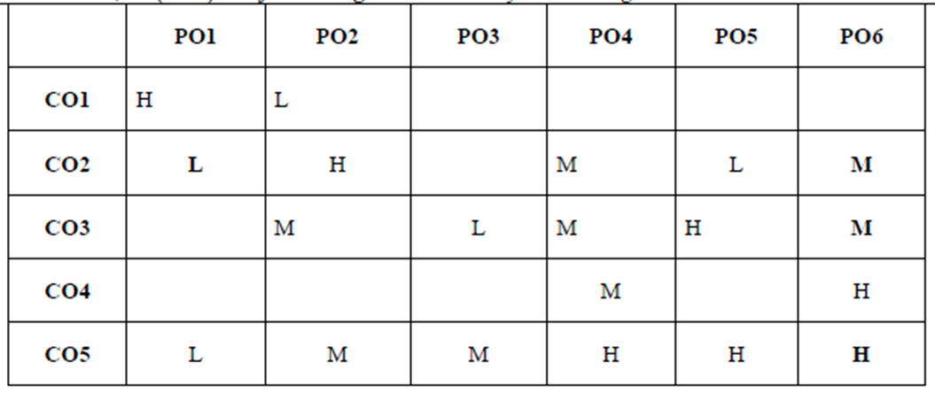
COs and POs Mapping
*1=High, *2=Medium, *3=Low

Slide 13
Program Educational Objectives (PEOs)
PEO 1: Graduates of the management program will have conceptual knowledge, to adapt to the rapidly changing environment, learn new skills and demonstrate application of management principles in a professional work setting.
PEO 2: Graduates will apply appropriate tools for decision making required for solving complex managerial problems in the local or global context.
PEO 3: Graduates of the management program will exhibit integrity, social responsibility, and teamwork.
PEO 4: Graduates will exhibit ethics, communication skills, leadership qualities and entrepreneurial mindset using creativity and innovation.

Slide 14
Result Analysis

Slide 15
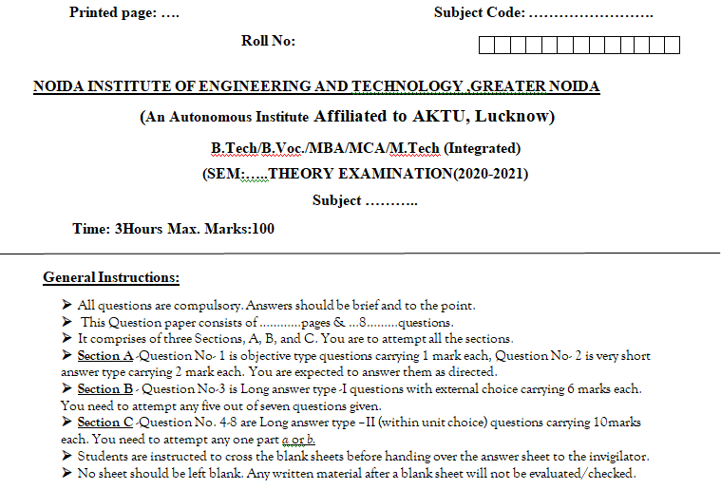
End Semester Question paper Templates

Slide 16
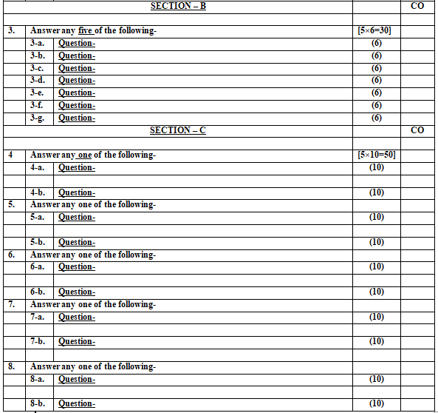
End Semester Question paper Templates

Slide 17
Prerequisite /Recap
Prerequisites for this session are:
General understanding of project management.
Moderate analytical skills.
Recap:
Project Identification & Selection
Market & Demand analysis techniques
Project Risk Management

Slide 18
Brief Introduction about the Subject with Videos
Project management is the discipline of initiating, planning, executing, controlling, and closing the work of a team to achieve specific goals and meet specific success criteria.
It involves the application of knowledge, skills, tools, and techniques to project activities to meet project requirements.
Effective project management ensures that projects are completed within scope, on time, and within budget, while delivering the desired outcomes.
https://www.youtube.com/watch?v=EyPFi0YO32M
https://www.youtube.com/watch?v=BOU1YP5NZVA

Slide 19
Unit Content
Fundamental components of Project Cost,
Types of Costs: Direct, Indirect, Recurring, Non-Recurring, Fixed, Variable, Normal,
Expedite costs
Methods of budgeting –
Project cost estimation –
Improving cost estimates –
Budget uncertainty and risk management –
Scheduling the project – Gantt chart –
Resource allocation and loading –
Social Cost Benefit Analysis (SCBA) of Project: Concept & significance of SCBA,
approaches to SCBA

Slide 20
Unit objective
Objective of this unit are:
To understand various aspects of Project Costing.
To learn about various Project Financing sources and preparing project budgets.
To understand and conduct he Social Cost Benefit Analysis (SCBA) of a Project.

Slide 21
Topic Objectives & Topic Outcome
S.NO | TOPIC OBJECTIVE | TOPIC OUTCOME
1 | To understand various aspects of Project Costing. | CO3

Slide 22
Project cost
The project cost is a cost required to procure all the needed products, services and resources to deliver the project successfully.
Example: In an example of a construction project, the cost estimation starts from land acquisition cost, construction cost, materials cost, administration cost, labor cost and other direct and indirect costs

Slide 23
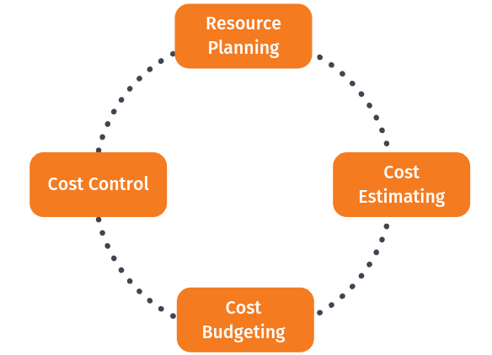
Fundamental Components of Project Costing

Slide 24
Step 1: resource planning
Resource planning is the process of ascertaining future resource requirements for an organization or a scope of work. This involves the evaluation and planning of the use of the physical, human, financial, and informational resources required to complete work activities and their tasks.
Most activities involve using people to perform work. Some activities involve materials and consumables.

Slide 25
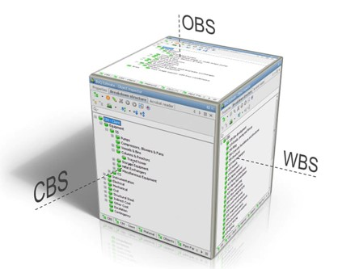
Step 1: resource planning
OBS: organizational breakdown structure.
WBS : work breakdown structure.
CBS: cost breakdown structure.

Slide 26
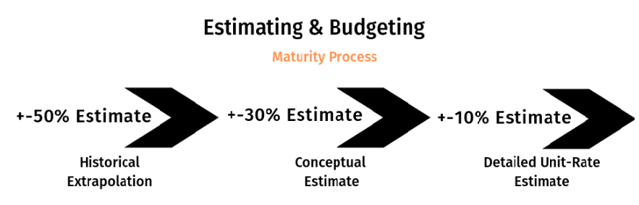
Step 2: Cost estimation

Slide 27
Step 3: Cost budgeting
Budgeting is a sub-process within estimating used for allocating the estimated cost of resources into cost accounts against which cost performance will be measured and assessed.
This forms the baseline for cost control.
Cost accounts used from the chart of accounts must also support the cost accounting process.
Budgets are often time-phased in accordance with the schedule or to address budget and cash flow constraints.

Slide 28
Step 4: Cost control
Cost control is concerned with measuring variances from the cost baseline and taking effective corrective action to achieve minimum costs.
Procedures are applied to monitor expenditures and performance against the progress of a project.
All changes to the cost baseline need to be recorded and the expected final total costs are continuously forecasted.

Slide 29
Elements of cost
Materials= Direct Materials+ Indirect Materials
Labour = Direct Labour + Indirect Labour
Expenses= Direct Expenses + Indirect Expenses
Total Cost= Prime Cost + Overheads

Slide 30
COST
The term ‘cost’ refers to the amount of expenditure incurred on, or attributable to a given things.
Cost of materials
Cost of labour
Cost of overheads
Other expenses

Slide 31
Total Cost= Prime Cost+ Overheads
Prime Cost:
Direct Materials (Prime material, process material, production material, requisitioned material)
Direct Labour or Wages (wages of labour, foreman etc)
Direct Expenses (chargeable expenses, process expenses, productive expenses and prime cost expenses)

Slide 32
Total Cost= Prime Cost+ Overheads
Overheads:
Indirect Materials (oil, grease, waste for machine, brooms, rags and cleaning materials)
Indirect Wages (wage of indirect labours like cleaners, store keeper time keepers, over time etc)
Indirect Expenses (rent, rates and taxes, insurance, canteen expenses, dispensary, hospital, power & lighting etc.

Slide 33
Other overheads
Factory or manufacturing or works or production overheads- (rent and rates of factory building, salary of production manager, supervisors, foreman, storekeeper etc.)
Administrative or office or general overheads- (rent and taxes of office building, staff salaries, postage and stationery, directors’ fee, bank charges etc.)
c. Selling and distribution overheads- (advertising expenses, salaries and commission to statement, market research expenses etc.)

Slide 34
Cost
Prime cost= Direct material+ Direct labour+ Direct expenses.
Works or Factory Cost= Prime cost+ Works or Factory Overheads.
Cost of Production= Works cost+ Administrative overheads
Total Cost or Cost of Sales= Cost of production+ Selling and distribution overheads.
Profit/Loss= Selling Price- Cost of Sales

Slide 35
Classification of cost based on (Function)
Production Cost
Administrative Cost
Selling and Distribution Costs
Research and Development Cost (optional)

Slide 36
Classification of cost based on (Behaviour)
Fixed Cost ( rent, salaries, lease costs, insurance and loan repayment.)
Variable Cost ( raw material, piece-rate labor, delivery costs, packaging supplies, and credit card fees.)
Semi variable cost (Normal maintenance of building and plant, depreciation of plant and machinery, service department wages.)

Slide 37
Direct and Indirect cost
Directs Costs:
Which can be traces with the level of activity completion.
Indirect Costs:
Which can not be traced with the level of activity completion

Slide 38
Recurring and non- recurring cost
Recurring cost : A recurring cost is one that occurs at regular intervals and is anticipated. The cost to provide electricity to a production facility is a recurring cost.
Non recurring cost : A non-recurring cost is one that occurs at irregular intervals and is not generally anticipated.

Slide 39
Normal and Expedite Cost
Normal Costs:
Are incurred when project tasks are completed according to actual plan duration.
Expedite Cost:
Unplanned cost incurred as result of steps taken to accelerate project completion.

Slide 40
Topic objective and topic outcome
s.no. | topic | CO
1 | To learn about various Project Financing sources and preparing project budgets. | CO3

Slide 41
Project Financing
Project financing is the funding (financing) of long-term infrastructure, industrial projects, and public services using a non-recourse or limited recourse financial structure.
The debt and equity used to finance the project are paid back from the cash flow generated by the project.

Slide 42
Key Features of Project Financing
Capital Intensive Financing Scheme
Risk Allocation
Multiple Participants Applicable
Asset Ownership is Decided at the Completion of Project
Asset Ownership is Decided at the Completion of Project
Loan Repayment With Project Cash Flow
Better Tax Treatment
Sponsor Credit Has No Impact on Project

Slide 43
Stages of project financing
Pre- Financing Stage
Financing Stage
Post-Financing stage

Slide 44
1. Pre-financing stage
1.1 - Identification of the Project Plan
1.2 - Recognising and Minimizing the Risk
1.3 - Checking Project Feasibility

Slide 45
2. Financing stage
2.1 - Arrangement of Finances
2.2 - Loan or Equity Negotiation
2.3 - Documentation and Verification
2.4 - Payment

Slide 46
3. Post-financing stage
3.1 - Timely Project Monitoring
3.2 - Project Closure
3.3 - Loan Repayment

Slide 47
Sources of Finance
Equity Capital
Preference Capital
Debentures
Rupees term loans
Foreign currency term loans
Euro issues

Slide 48
Sources of Finance cont..
Unsecured loans and deposits
Lease and hire purchase finance
Public Deposit
Bank Credit
Deferred credit
Bill rediscounting scheme
Suppliers line of credit
Seed capital assistance

Slide 49
Government Financing Schemes
1. The Venture Capital Assistance Scheme
Ministry of Agriculture and Farmers Welfare
2. Stand-Up India for Financing SC/ST and/or Women Entrepreneurs
Small Industries Development Bank of India (SIDBI)
3.Dairy Entrepreneurship Development Scheme
National Bank for Agriculture and Rural Development (NABARD)

Slide 50
Project Budgeting- Project Budget
The Project Budget is a tool used by project managers to estimate the total cost of a project.
A project budget template includes a detailed estimate of all costs that are likely to be incurred before the project is completed.

Slide 51
Need of project budget
There are many components necessary to build a budget, including direct and indirect costs, fixed and variable costs, labor and materials, travel, equipment and space, licenses and whatever else may impact your project expenses.
To meet all the financial needs of your project, a project budget must be created thoroughly, not missing any aspect that requires funding.

Slide 52
Steps in Project Budgeting
1. Use Historical Data
2. Reference Lessons Learned
3. Leverage Your Experts
4. Confirm Accuracy
5. Baseline and Re-Baseline the Budget
6. Update in Real Time
7. Get on Track

Slide 53
Types of Project Budgeting
1. Top-down budgeting
2. Bottom-up budgeting

Slide 54
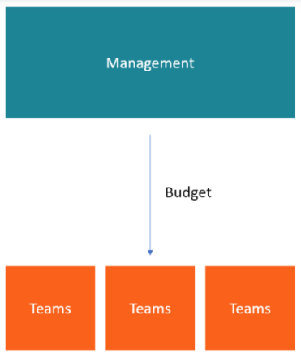
Top-down budgeting
Sometimes, the managers may put forward suggestions for the budget before the budget preparation.
Whether their contribution to the budgeting process will be used or not is at the management’s discretion.
After the budget is created, the management makes specific allocations to the different departments, which must then create their own budgets based on their budget allocation and goals.

Slide 55
Advantages of top-down budgeting
It allows management to allocate resources to departments to propel the growth of the company, starting with the most critical departments.
Saves time for lower management. Rather than spending time creating a budget from scratch, lower-level managers are given an already-formulated budget to implement.
Creates one budget at a time, rather than allowing departments to develop their budgets and later combine them. As a result, the budgeting process will be less tedious.

Slide 56
Disadvantages of top-down budgeting
The level of motivation decreases since the managers who are required to implement the budget do not own the budget-making process.
2. Senior managers are not involved in the day-to-day operations of individual departments, so they may not have realistic expectations of the expenses related to each department.

Slide 57
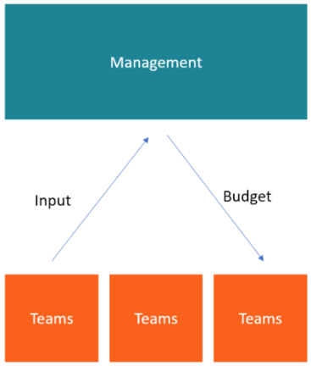
Bottom-up budgeting
Bottom-up budgeting starts at the department level and moves up to the top management.
The departmental heads/managers prepare their budgets based on present information and past experiences and present them to senior management for approval.

Slide 58
Advantages of Bottom-up budgeting
Typically very accurate because each department uses its specialized knowledge to create the individual line items of its budget.
Improves company morale and employee motivation since the whole team gets involved in formulating the budget and takes more ownership over achieving budgeted targets.
Helps management gain a deeper understanding and commitment to the business goals.

Slide 59
Disadvantages of Bottom-up budgeting
Departments can become guilty of over-budgeting, getting too buried in detail and trying to budget for every single staple and pencil.
2. A department may set budget targets that are too easily achievable, and inexperienced managers could make poor decisions when estimating and calculating budget numbers.
3. The budgeting process may also take significantly longer because of all the people and departments involved.

Slide 60
Topic Objectives & Outcome
s.no. | topic | outcomes
1 | To learn about the social cost benefit analysis of projects and doing SCBA for projects using different methods. | CO3

Slide 61
Social Cost Benefit Analysis (SCBA)
The social cost-benefit analysis is a tool for evaluating the value of money, particularly of public investments in many economies.
It aids in making decisions concerning the various aspects of a project and the design programs of closely interrelated projects.
Cost-benefit analysis has become important among economists and consultants in recent years.

Slide 62
Rationale Behind SCBA
In Social-Cost Benefit Analysis (SCBA) the focus is on social costs and benefits of a project. These often tend to differ from the costs incurred in monetary terms and benefits earned in monetary terms by the project.
The principal reasons for the discrepancy are:
Market imperfections
Externalities
Taxes and subsidies
Concern for savings
Concern for redistribution
Merit wants

Slide 63
UNIDO Approach to SCBA
Calculation of financial profitability of the project measured at market prices.
Obtaining the net benefit of project measured in terms of economic (efficiency) prices.
Adjustment for the impact of the project on savings and investment.
Adjustment for the impact of the project on income distribution.
Adjustment for the impact of project on merit goods and demerit goods whose social values differ from their economic values.

Slide 64
UNIDO Approach
Stage 1
The financial profitability of the projects is calculated by taking the projected financial statements that serve as a focus for future earnings and sustainability of the projects

Slide 65
UNIDO Approach
Stage 2
Stage two of the UNIDO approach is Concerned with the determination of the net benefit of the project in terms of economic (efficiency) prices, also referred to as shadow prices.

Slide 66
Shadow Pricing
The UNIDO approach suggests following sources of shadow pricing, depending on the impact of the project on national economy. A project as it uses and produces resources may for any given input or output
(i) increase or decrease the total consumption in the economy,
(ii) decrease or increase production in the economy,
(iii) decrease imports or increase imports, or
(iv) increase exports or decrease exports.

Slide 67
NON-TRADABLE INPUTS AND OUTPUTS
A good is non-tradable when the following conditions are satisfied:
I) its import price is greater than its domestic cost of production and
(ii) its export price is less than its domestic cost of production.

Slide 68
Externalities
An externality, also referred to as an external effect, is a special class of good which has the following characteristics:
(i) It is not deliberately created by the project sponsor but is an incidental outcome of legitimate economic activity,
(ii) It is beyond the control of the persons who are affected by it, for better or for worse.
(iii) It is not traded in the marketplace.
An external effect may be beneficial or harmful.

Slide 69
UNIDO Approach
Stage 3 & 4
Stages three and four of the UNIDO method are concerned with measuring the value of a project in terms of its contribution to savings
and income redistribution.
To facilitate such assessments we must first measure the income gained or lost by individual groups within the society.

Slide 70
How to distribute society?
For income distribution analysis, the society may be divided into various groups. The UNIDO approach seeks to identify income gains and losses by the following:
(i) Project,
(ii) Other private business,
(iii) Government,
(iv) Workers,
(v) Consumers,
(vi) External sector.

Slide 71
Stage 3 Savings impact and its value
Stage three of the UNIDO method, concerned with this, seeks to answer the following questions:
(i) Given the income distribution impact of the project what would be its effect on savings?
(ii) What is the value of such savings to the society?
Impact on savings of a project = ΣΔYiMPSi
where, ΔYi = change in income of group i as a result of the project
MPSi = marginal propensity to save of group i

Slide 72
Stage 3 Savings impact and its value
If the marginal productivity of capital is r and the rate of reinvestment from additional income a, the additional stream of consumption generated by a rupee of investment can be worked out.
The consumption stream starts with r (1 – a) and grows annually at the rate of ar forever.

Slide 73
Stage 3 Savings impact and its value
I = r(1-a) / (k-ar)
where,
I = social value of a rupee of savings (investment)
r = marginal productivity of capital
a = reinvestment rate on additional income arising from investment
k = social discount rate.

Slide 74
Income Distribution Impact
Many Governments regard redistribution of income in favor of economically weaker sections or economically backward regions as a socially desirable objective.
Due to practical difficulties in pursuing the objective of redistribution entirely through the tax, subsidy, and transfer measures of the government, investment projects are also considered as instruments for income redistribution, and their contribution toward this goal is considered in their evaluation.

Slide 75
Adjustment for Merit and Demerit Goods
In some cases, the analysis has to be extended beyond stage four to reflect the difference between the economic value and social value of resources. This difference exists in the case of merit goods and demerit goods.
A merit good is one for which the social value exceeds the economic value.
In the case of a demerit good, the social value of the good is less than its economic value

Slide 76
Adjusting for the difference between social value and economic value
(i) Estimate the economic value.
(ii) Calculate the adjustment factor as a difference between the ratio of social value to economic value and unity.
(iii) Multiply the economic value by the adjustment factor to obtain the adjustment.
(iv) Add the adjustment to the net present value of the project as calculated in stage four.

Slide 77
Little-Mirrlee’s Approach to SCBA
The LM Approach provides a comprehensive framework for SCBA in developing countries.
The approach has been named on the basis of their developers i.e. L. M. D. Little and J. A. Mirrlee’s.

Slide 78
Little-Mirrlee’s Approach to SCBA
Under the LM approach costs and benefits are measured in terms of international prices, also referred to as border prices. The following are the provisions related to traded goods:
1. FOB Price(MOVEMENT BORNE BY SELLER): if a good is exported, its shadow price is its FOB price.
2. CIF Price(SELLER’S RESPONSIBILITY FOR THE COST, INSURANCE, FREIGHT): If a good is imported its shadow price is it CIF price.

Slide 79
Little-Merrilee's Approach to SCBA
Shadow Prices of Non-Traded Goods:
Shadow prices of non-traded goods are defined in terms of marginal social cost and benefit. The resource used to produce an extra unit of a good is the marginal cost of a good. The value of an extra unit of the good from social point of view is the marginal social benefit

Slide 80
Little-Mirrlee’s Approach to SCBA
Shadow Prices of Non-Traded Goods:
When a good is not taxed and is consumed by only one income group, then its marginal social benefit is equal to its market price multiplied by a factor that represents the value assigned to an increase in the income of that group vis-vis a consumption is 2:1,
then the shadow price of the non-traded output will be:
2/3 marginal social cost + 1/3 marginal social benefit

Slide 81
Case Study

Slide 82
Daily quiz
Q1. Discuss the fixed cost.
Q2. Describe the variable cost.
Q3. Explain the normal and expedite cost.
Q4. Explain the top down budgeting.
Q5. Discuss the bottom of budgeting.

Slide 83
Daily quiz
Q6. The cost of project represents the_______ of all items of outlet associated.
Total
Partial
Both the above
None of the above
Q7. The cost of land at a given time varies considerably from one_______ to another.
A. Location
B. Seller
C. Buyer
D. None of these

Slide 84
Daily quiz
Q8. From the private point of view, taxes are.
Definite monetary costs
Definite monetary gains
Definite monetary losses
None of the above
Q9. The common market imperfections found in developing countries are:
Rationing,
Prescription of minimum wage rates
Foreign exchange regulation.
All of the above

Slide 85
Weekly assignment
Describe various costs associated with project management.
Enumerate various project financing sources
Discuss the Social Cost Benefit Analysis (SCBA). Describe the UNIDO approach to SCBA
Discuss various approaches of project budgeting.

Slide 86
Topic links
https://www.youtube.com/watch?v=KBhREhTe82Q
https://www.youtube.com/watch?v=Ni95eCqOMhg
https://www.youtube.com/watch?v=2HjrfMhvPFI
https://www.youtube.com/watch?v=HY6tVBQXbOg

Slide 87
MCQs
Q1. Most of the projects incur cash losses in the________.
Initial years
During the peak
Later years
None of these
Q2. Equity shareholders are the________ of the business.
Debtors
Owners
Borrowers
None of the above

Slide 88
MCQs
Q3. Debentures are the instrument for raising the_______
Equity capital
Debt capital
Preference capital
All of the above
Q4. The cost which does not change with the level of activity in short run is known as
Variable cost
Fixed cost
Average cost
None of the above

Slide 89
MCQs
Q5. SCBA stands for.
Social cost benefit analysis
Society contribution for beta analysis
Singular characteristic beta aggregation
None of the above
Q6. When imperfections obtain, market prices do not reflect.
Economic value
Social value
Financial value
Intrinsic value

Slide 90
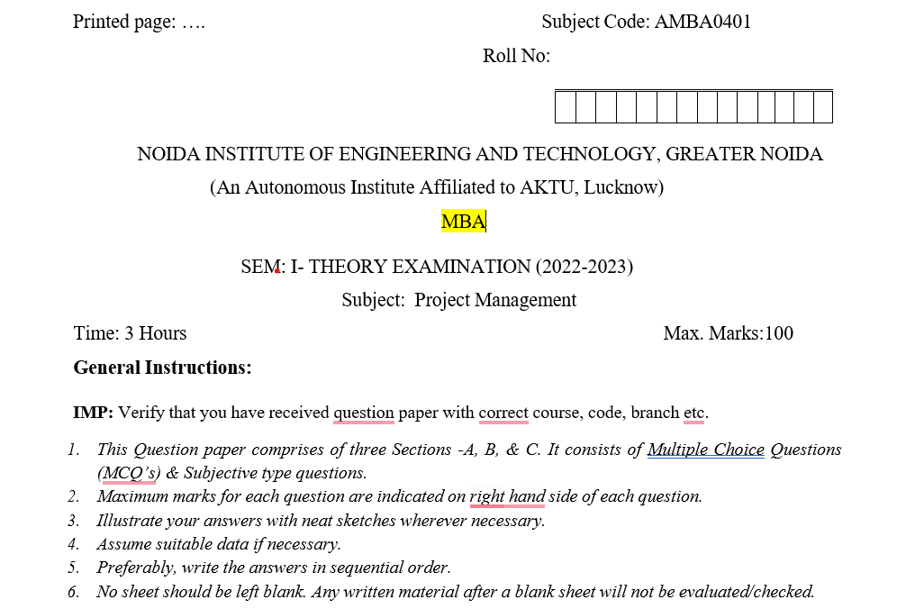
Old question paper

Slide 91
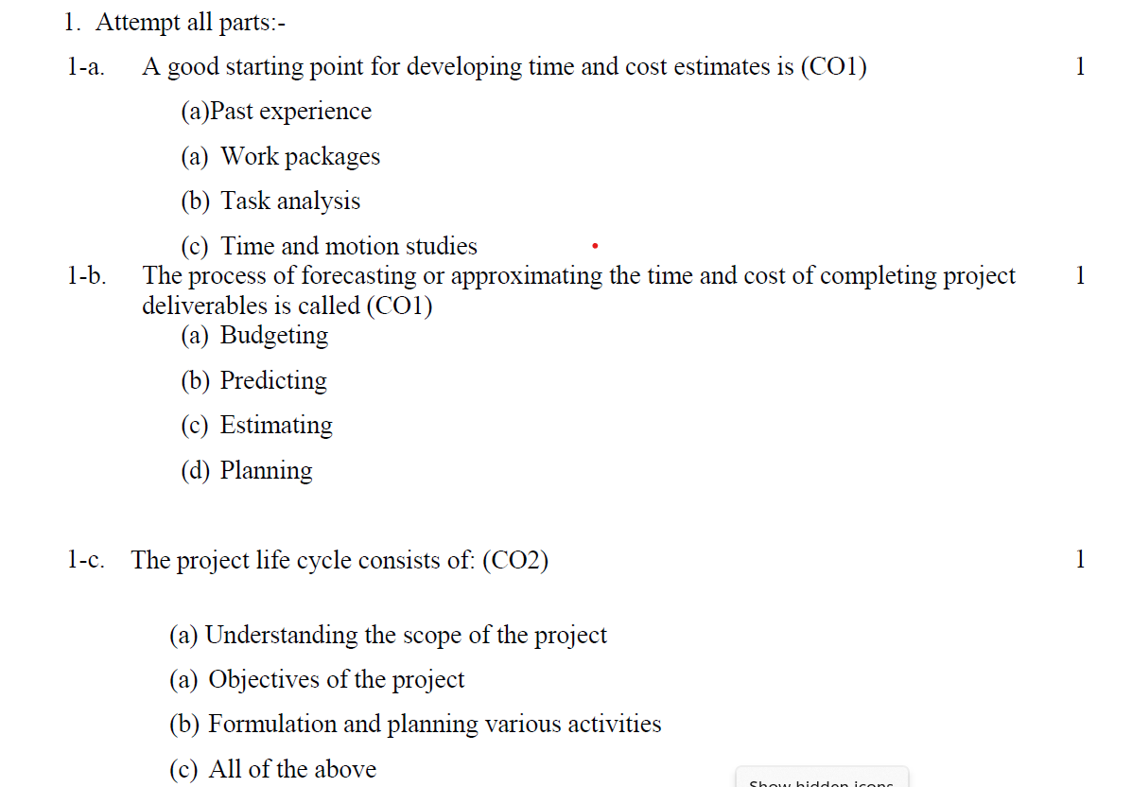
Old question paper

Slide 92
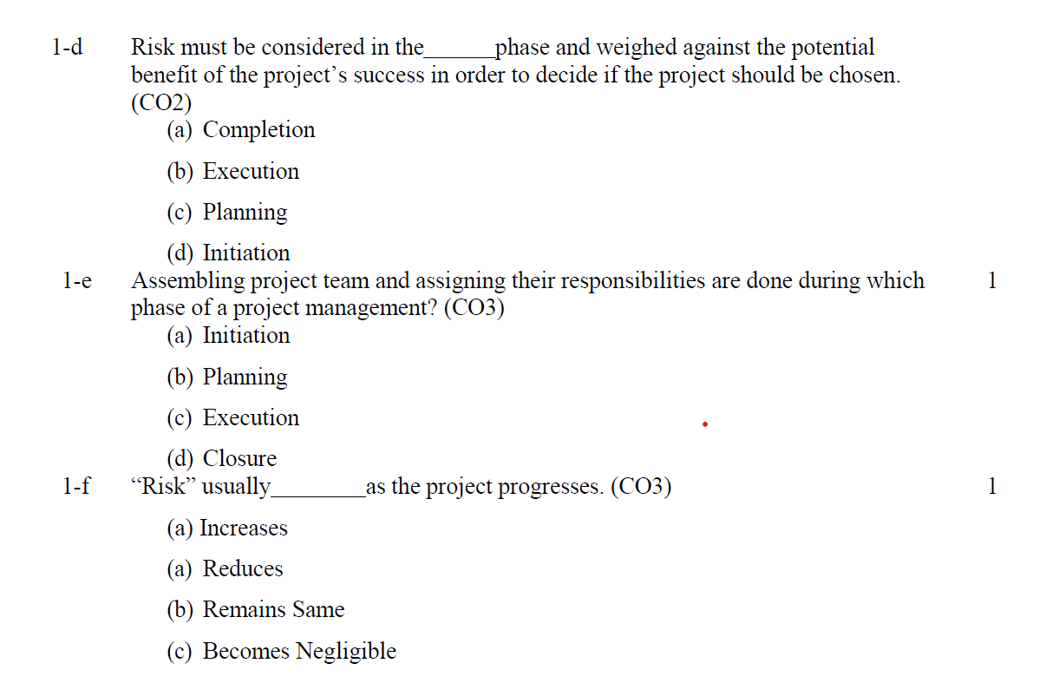
Old question paper

Slide 93
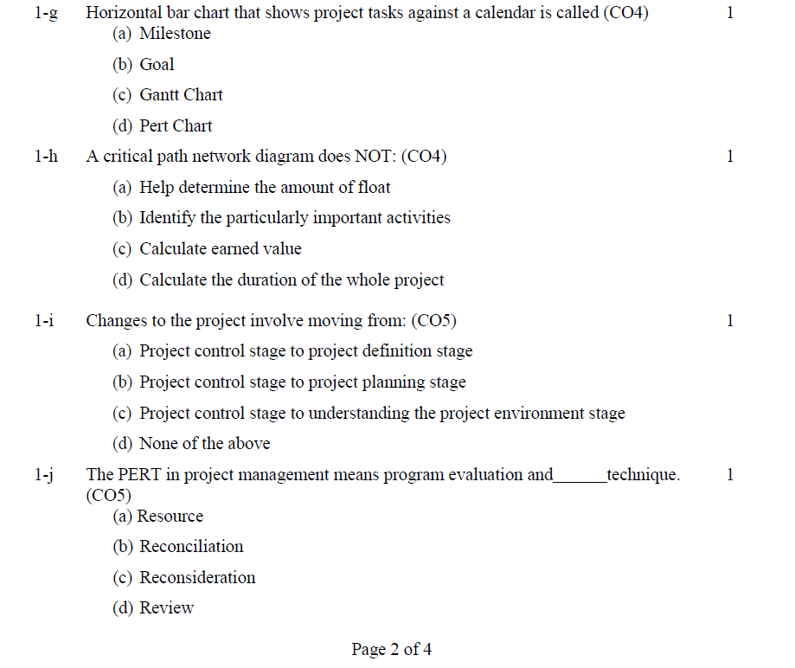
Old question paper

Slide 94
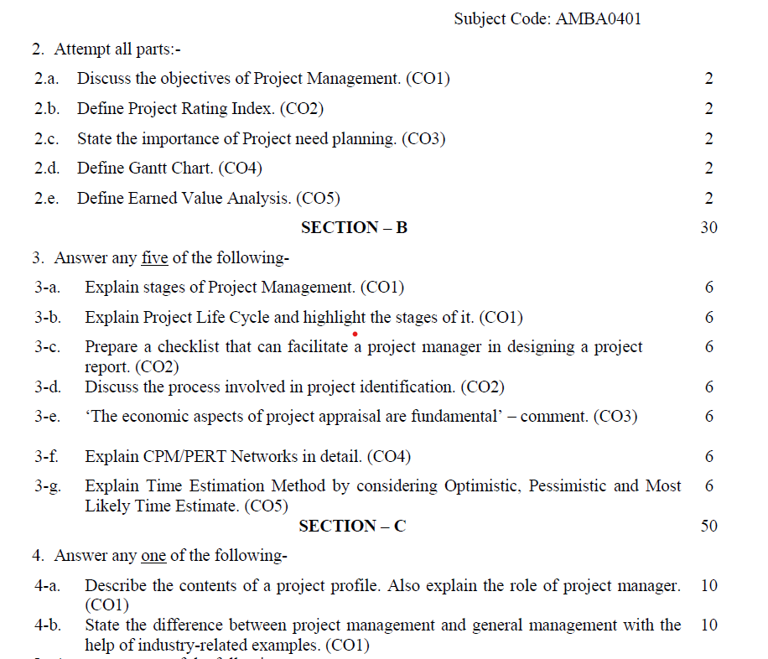
Old question paper

Slide 95
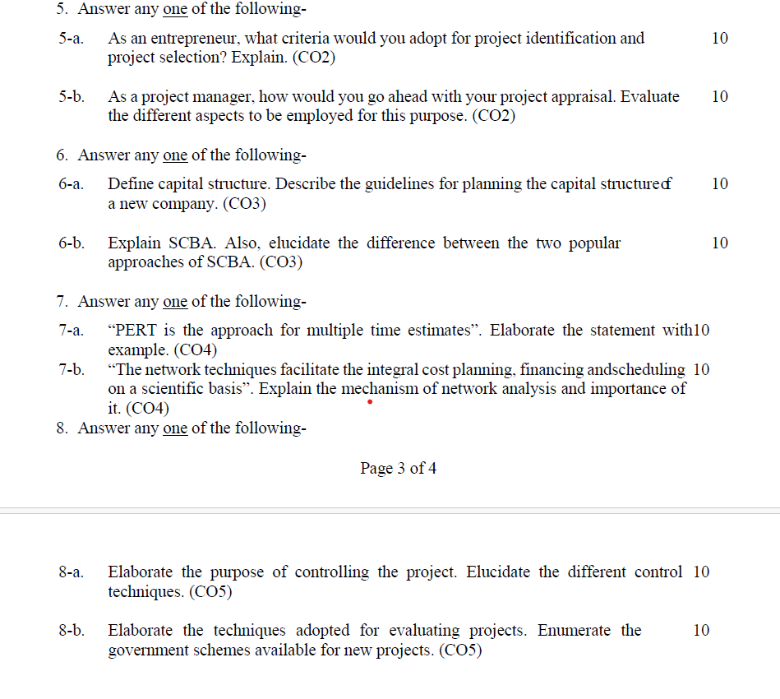
Old question paper

Slide 96
Expected Questions
Q1. Discuss the various types of cost associated with the project management.
Q2. Elaborate the Little-Mirrlees approach of social cost benefit analysis.
Q3. Explain social cost benefit analysis. Discuss the UNIDO approach of this analysis.
Q4. Differentiate between the top-down and bottom-up budgeting.
Q5. Explain the various sources of project financing in India.

Slide 97
Recap of unit
Resource planning is the process of ascertaining future resource requirements for an organization or a scope of work.
Budgeting is a sub-process within estimating used for allocating the estimated cost of resources into cost accounts against which cost performance will be measured and assessed. This forms the baseline for cost control.
Under LM approach costs and benefits are measured in terms of international prices, also referred as border prices.

